Slide 1
Object Pool Pattern
By
Narendran, S S

Slide 2
Key Items
Manage Object Pool
Acquiring and Releasing Objects
Object Pool – Antipattern – Cesspools
Object Pool in concurrent
Thread Starving, Leaking

Slide 3
Object Pool Pattern
The object pool pattern is a software creational design pattern that uses a set of initialized objects kept ready to use, rather than allocating and destroying them on demand. A client of the pool will request an object from the pool and perform operations on the returned object. When the client has finished, it returns the object, which is a specific type of factory object, to the pool rather than destroying it.

Slide 4
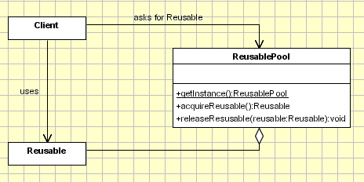
Prototype Pattern - UML

Slide 5
Antipattern
Object pools full of objects with dangerously stale state are sometimes called object cesspools and regarded as an anti-pattern.
The pool is responsible for resetting the objects, not the clients.

Slide 6
JAVA Support
Java supports thread pooling via java.util.concurrent.ExecutorService and other related classes

Slide 7
Rule of Thumb
The Factory Method pattern can be used to encapsulate the creation logic for objects. However, it does not manage them after their creation, the object pool pattern keeps track of the objects it creates.
Object Pools are usually implemented as Singletons. (It is desirable to keep all Reusable objects that are not currently in use in the same object pool so that they can be managed by one coherent policy. To achieve this, the Reusable Pool class is designed to be a singleton class.)

Slide 8
Pros and Cons
Pros
Object pooling can offer a significant performance boost in situations where the cost of initializing a class instance is high, the rate of instantiation of a class is high, and the number of instances in use at any one time is low. The pooled object is obtained in predictable time when creation of the new objects (especially over network) may take variable time.
Cons
However these benefits are mostly true for objects that are expensive with respect to time, such as database connections, socket connections, threads and large graphic objects like fonts or bitmaps. In certain situations, simple object pooling (that hold no external resources, but only occupy memory) may not be efficient and could decrease performance

Slide 9
References
http://sourcemaking.com/design_patterns/object_pool
http://en.wikipedia.org/wiki/Object_pool_pattern

